Slide 1


Parallel Computing with GPUs: Shared Memory
Dr Paul Richmond
http://paulrichmond.shef.ac.uk/teaching/COM4521/

Slide 2
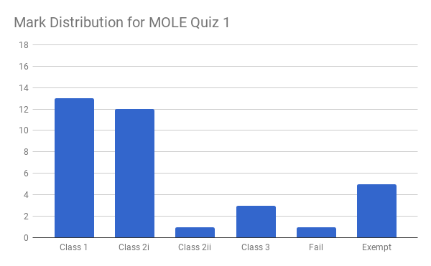
Average Mark: 71%

Slide 3



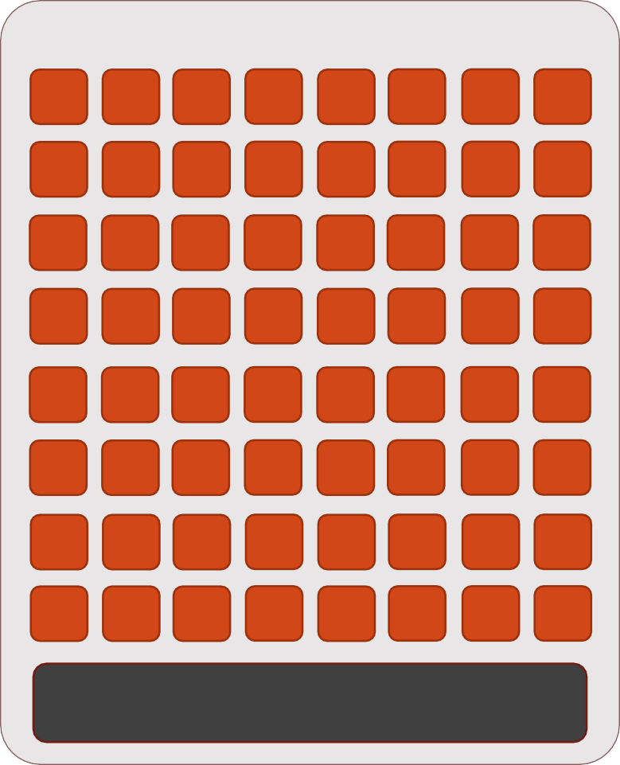










Grids, Blocks, Warps & Threads
32 CUDA core partitions – execute warps
GPU
SM
SM
Grid
SM
SM
Device Memory
Block
Shared Memory / Local Cache
Thread

Slide 4
Grids, Blocks, Warps & Threads
Blocks map to SMs
SMs may have more than one block
Blocks are split into warps by hardware (always pick block size multiple of 32)
Blocks do not migrate between SMs
No guarantee of order of block execution
No communication or synchronisation between blocks
Threads map to CUDA cores
Executed in partitions of 32, called warps
Lots of warps means lots of opportunity to hide memory movement

Slide 5
Review of last week
We have seen the importance of different types of memory
And observed the performance improvement from read-only and constant cache usage
So far we have seen how CUDA can be used for performing thread local computations; e.g.
Load data from memory to registers
Perform thread-local computations
Store results back to global memory
We will now consider another important type of memory
Shared memory

Slide 6
Shared Memory
Shared Memory Bank Conflicts
2D Shared Memory Bank Conflicts
Boundary Conditions for Shared Memory Loading
Host-side Configurations for Shared Memory

Slide 7
Shared Memory
Architecture Details
In Kepler (64KB) of Shared Memory is split between Shared Memory and L1 cache
The ratio to SM and L1 can be configured
In Maxwell 64KB of Shared Memory is dedicated
Its just another Cache, right?
User configurable
Requires manually loading and synchronising data
Kepler
Maxwell
Block (0, 0)
Block (0, 0)
Registers
Registers
Registers
Registers
Thread (0, 0)
Thread (1, 0)
Thread (0, 0)
Thread (1, 0)
Local Cache
Local Cache
Shared Mem/ L1
Constant Cache
Read-only Cache
Shared Mem
Constant Cache
L1 / Read-only

Slide 8
Shared Memory
Performance
Shared memory is very fast
Bandwidth > 1 TB/s
Block level computation
Challenges the thread level view…
Allows data to be shared between threads in the same block
User configurable cache at the thread block level
Still no broader synchronisation beyond the level of thread blocks

Slide 9
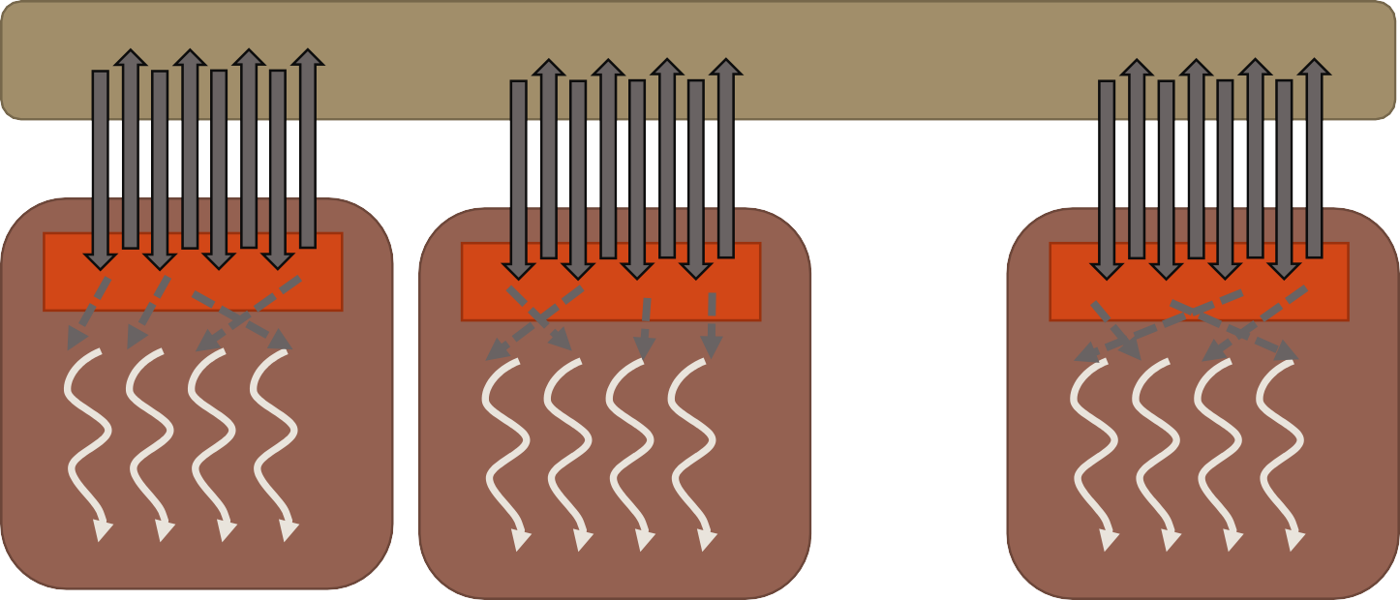
Block Local Computation
Partition data into groups that fit into shared memory
Load subset of data into shared memory
Perform computation on the subset
Copy subset back to global memory
………

Slide 10
Move, execute, move
From Host view
Move: Data to GPU memory
Execute: Kernel
Move: Data back to host
From Device view
Move: Data from device memory to registers
Execute: instructions
Move: Data back to device memory
From Host view
Move: Data to GPU memory
Execute: Kernel
Move: Data back to host
From Device view
Move: Data from device memory to local cache
Execute: subset of kernel (reusing cached values)
Move: Data back to device memory
From Block View
Move: Data from local cache
Execute: instructions
Move: Data back to local cache (or device memory)
Block level parallelism
Thread level parallelism

Slide 11

A Case for Shared Memory
global void sum3_kernel(int *c, int *a)
{
int i = blockIdx.x*blockDim.x + threadIdx.x; int left, right;
//load value at i-1 left = 0;
if (i > 0)
left = a[i - 1];
//load value at i+1
right = 0;
if (i < (N - 1))
right = a[i + 1];
c[i] = left + a[i] + right; //sum three values
}
Do we have a candidate for block level parallelism using shared memory?

Slide 12
A Case for Shared Memory
global void sum3_kernel(int *c, int *a)
{
int i = blockIdx.x*blockDim.x + threadIdx.x; int left, right;
//load value at i-1 left = 0;
if (i > 0)
left = a[i - 1];
//load value at i+1
right = 0;
if (i < (N - 1))
right = a[i + 1];
c[i] = left + a[i] + right; //sum three values
}
Currently: Thread-local computation
Bandwidth limited
Requires three loads per thread (at index i-1, i, and i+1)
Block level solution: load each value only once!

Slide 13
CUDA Shared memory
Shared memory between threads in the same block can be defined using shared
Shared variables are only accessible from within device functions
Not addressable in host code
Must be careful to avoid race conditions
Multiple threads writing to the same shared memory variable
Results in undefined behaviour
Typically write to shared memory using threadIdx
Thread level synchronisation is available through syncthreads()
Synchronises threads in the block
shared int s_data[BLOCK_SIZE];

Slide 14
Example
global void sum3_kernel(int *c, int *a)
__shared int s_data[BLOCK_SIZE];
int i = blockIdx.x*blockDim.x + threadIdx.x; int left, right;
s_data[threadIdx.x] = a[i];
__syncthreads();
//load value at i-1 left = 0;
if (i > 0){
left = s_data[threadIdx.x - 1];
}
//load value at i+1 right = 0;
if (i < (N - 1)){
right = s_data[threadIdx.x + 1];
}
c[i] = left + s_data[threadIdx.x] + right; //sum
Allocate a shared array
One integer element per thread
Each thread loads a single item to shared memory
Call syncthreads to ensure shared memory data is populated by all threads
Load all elements through shared memory
What is wrong with this code?
{
}

Slide 15
Example
Additional step required!
Check boundary conditions for the edge of the block
global void sum3_kernel(int *c, int *a)
__shared int s_data[BLOCK_SIZE];
int i = blockIdx.x*blockDim.x + threadIdx.x; int left, right;
s_data[threadIdx.x] = a[i];
__syncthreads();
//load value at i-1 left = 0;
if (i > 0){
if (threadIdx.x > 0)
left = s_data[threadIdx.x - 1];
else
left = a[i - 1];
}
//load value at i+1 right = 0;
if (i < (N - 1)){
if (threadIdx.x <(BLOCK_SIZE-1))
right = s_data[threadIdx.x + 1];
else
right = a[i + 1];
}
c[i] = left + s_data[threadIdx.x] + right; //sum
{
}

Slide 16
Problems with Shared memory
In the example we saw the introduction of boundary conditions
Global loads still present at boundaries
We have introduced divergence in the code (remember the SIMD model)
This is even more prevalent in 2D examples where we tile data into shared memory
//boundary condition
left = 0; if (i > 0){
if (threadIdx.x > 0)
left = s_data[threadIdx.x - 1]; else
left = a[i - 1];
}

Slide 17
Shared Memory
Shared Memory Bank Conflicts
2D Shared Memory Bank Conflicts
Boundary Conditions for Shared Memory Loading
Host-side Configurations for Shared Memory

Slide 18
Shared Memory Bank Conflicts
Shared memory is arranged into 4byte (32bit banks)
A load or store of 𝑁 addresses spanning 𝑁 distinct banks can be serviced simultaneously
Overall bandwidth of × 𝑁 a single module
Kepler+ can also serve broadcast accesses simultaneously
A bank conflict occurs when two threads request addresses from the same bank
Results in serialisation of the access
Bank conflicts only occur between threads in a warp
There are 32 banks and 32 threads per warp
If two threads in a warp access the same bank this is said to be a 2-way bank conflict
Think about you block sized array of floats
bank = (index * stride) % 32

Slide 19
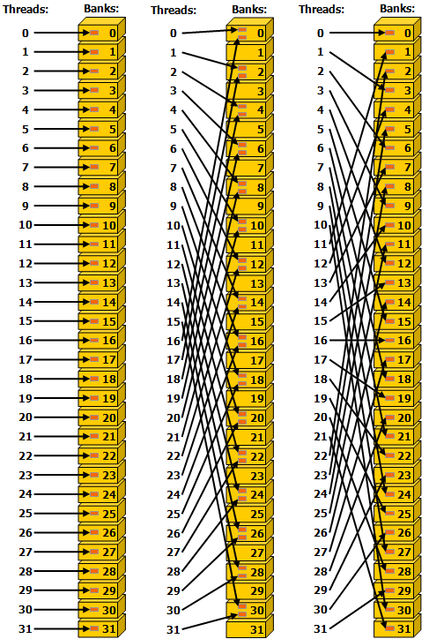
Stride=1
Stride=2
Stride=3
Access Strides
Stride refers to the size (in increments of the bank size) between each threads memory access pattern
If threads access consecutive 4 byte values (e.g. int or float) then the stride is 1.
No conflicts
If a thread accesses consecutive 8 bytes values (e.g. double) then the stride is 2.
2 way conflicts
In general odd strides result in
no conflicts

Slide 20
Stride (4 byte) |  | 1
TPB |  | 128
threadIdx.x |  |  |  | index | bank
0 |  |  |  | 0 | 1
1 |  |  |  | 1 | 2
2 |  |  |  | 2 | 3
3 |  |  |  | 3 | 4
4 |  |  |  | 4 | 5
5 |  |  |  | 5 | 6
6 |  |  |  | 6 | 7
7 |  |  |  | 7 | 8
8 |  |  |  | 8 | 9
9 |  |  |  | 9 | 10
10 |  |  |  | 10 | 11
31 |  |  |  | 31 | 12
 |  |  |  | Banks Used | 32
 |  |  |  | Max Conflicts | 1
bank = (index*stride) % 32

Slide 21
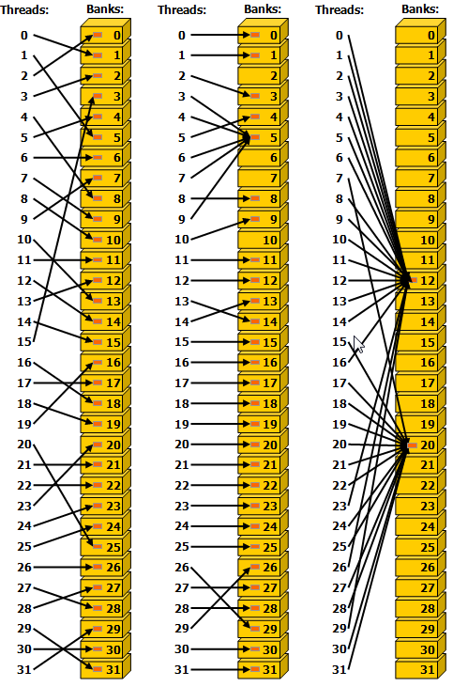
More on SM banks
Irregular access is fine as long as no bank conflicts
Multiple threads can access the same bank conflict free if they access addresses in broadcast
Broadcast can be to any number of threads in a warp
shared float s_data[??];
//read from shared memory using broadcast
some_thread_value = s_data[0] ;

Slide 22
Thread 0
1
2
3
4
5
6
7
Bank
Strided access example
0
1
shared char s_data[BLOCK_SIZE];
//load or calculate some_thread_value s_data[threadIdx.x] = some_thread_value;
syncthreads();
2
3
4
5
6
7
…
31
31
What is the stride?
What is the level of conflict?
How can this be improved?

Slide 23
Thread 0
1
2
3
4
5
6
7
Bank
Strided access example
0
1
shared char s_data[BLOCK_SIZE];
//load or calculate some_thread_value s_data[threadIdx.x] = some_thread_value;
syncthreads();
2
3
4
5
6
7
…
What is the stride? Less than 1 (0.25)
What is the level of conflict? 4 way
How can this be improved? Increase the stride

Slide 24
Thread 0
1
2
3
4
5
6
7
Bank
Increase the stride (OK solution)
0
1
shared char s_data[BLOCK_SIZE*4];
//load or calculate some_thread_value s_data[threadIdx.x*4] = some_thread_value;
syncthreads();
2
3
4
5
6
7
…
What is the stride? 1
What is the level of conflict? 1 way (no conflict)
How can this be improved? Use less memory!

Slide 25
Thread 0
1
2
3
4
5
6
7
Bank
Increase the stride (good solution)
0
1
shared char s_data[BLOCK_SIZE+1];
//load or calculate some_thread_value s_data[CONFLICT_FREE(threadIdx.x)] = some_thread_value;
syncthreads();
2
3
4
5
6
7
where
…
#define CHAR_MULTIPLIER 4
#define CONFLICT_FREE(x) (x*CHAR_MULTIPLIER % (BLOCK_SIZE+1))
31
31
What is the stride? 1
What is the level of conflict? 1 way (no conflict)
How much shared memory is required? BLOCK_SIZE+1

Slide 26
Increase the stride (good solution)
stride |  | 0.25
multipier |  | 4
block_size |  | 128
threadIdx.x |  |  |  | adjusted index | bank
0 |  |  |  | 0 | 0
1 |  |  |  | 4 | 1
2 |  |  |  | 8 | 2
3 |  |  |  | 12 | 3
4 |  |  |  | 16 | 4
5 |  |  |  | 20 | 5
6 |  |  |  | 24 | 6
7 |  |  |  | 28 | 7
8 |  |  |  | 32 | 8
9 |  |  |  | 36 | 9
10 |  |  |  | 40 | 10
… |  |  |  | … | …
127 |  |  |  | 121 | 30
 |  |  | Banks Used |  | 32
 |  |  | Max Conflicts |  | 1
=(tid*multiplier) % (block_size+1)
=(index*stride) % 32
BLOCK_SIZE+1 unique indices
Much better than
BLOCK_SIZE*4 unique indices

Slide 27
Shared Memory
Shared Memory Bank Conflicts
2D Shared Memory Bank Conflicts
Boundary Conditions for Shared Memory Loading
Host-side Configurations for Shared Memory

Slide 28
Bank conflicts with 2D tiles
global void image_kernel(float *image)
{
shared float s_data[BLOCK_DIM][BLOCK_DIM];
for (int i = 0; i < BLOCK_DIM; i++){ some_thread_value += f(s_data[threadIdx.x][i]);
}
Example where each thread (of 2D block) operates on a row
Loads values by column
bank = threadIdx.x * stride % 32
Shared Memory Bank
0 1 2 3 4 5
0 1 2 3 4 5
0 1 2 3 4 5
0 1 2 3 4 5
0 1 2 3 4 5
0 1 2 3 4 5
0 1 2 3 4 5
0 1 2 3 4 5
6
7
31
6
7
31
6
7
31
6
7
31
6
7
31
6
7
31
6
7
31
6
7
31
0
1
2
3
4
5
6
7
0

Slide 29
Bank conflicts with 2D tiles
global void image_kernel(float *image)
{
shared float s_data[BLOCK_DIM][BLOCK_DIM];
for (int i = 0; i < BLOCK_DIM; i++){ some_thread_value += f(s_data[threadIdx.x][i]);
}
Example where each thread (of 2D block) operates on a row
Loads values by column
bank = threadIdx.x * stride % 32
BLOCK_DIM=32
Shared Memory Bank
0 1 2 3 4 5
0 1 2 3 4 5
0 1 2 3 4 5
0 1 2 3 4 5
0 1 2 3 4 5
0 1 2 3 4 5
0 1 2 3 4 5
0 1 2 3 4 5
32 way bank conflicts!
Very bad
Stride = 32
6
7
31
6
7
31
6
7
31
6
7
31
i=0
6
7
31
6
7
31
6
7
31
6
7
31
0
1
2
3
4
5
6
7
0

Slide 30
Bank conflicts with 2D tiles
global void image_kernel(float *image)
{
shared float s_data[BLOCK_DIM][BLOCK_DIM];
for (int i = 0; i < BLOCK_DIM; i++){ some_thread_value += f(s_data[threadIdx.x][i]);
}
Example where each thread (of 2D block) operates on a row
Loads values by column
bank = threadIdx.x * stride % 32
BLOCK_DIM=32
Shared Memory Bank
0 1 2 3 4 5
0 1 2 3 4 5
0 1 2 3 4 5
0 1 2 3 4 5
0 1 2 3 4 5
0 1 2 3 4 5
0 1 2 3 4 5
0 1 2 3 4 5
How to fix
Memory padding
Transpose the matrix
Or operate on columns (loading by row) if possible
6
7
31
6
7
31
6
7
31
6
7
31
i=0
6
7
31
6
7
31
6
7
31
6
7
31
0
1
2
3
4
5
6
7
0

Slide 31
Bank conflicts with 2D tiles
global void image_kernel(float *image)
{
shared float s_data[BLOCK_DIM][BLOCK_DIM+1];
for (int i = 0; i < BLOCK_DIM; i++){ some_thread_value += f(d_data[threadIdx.x][i]);
}
Memory Padding Solution
bank = threadIdx.x * stride %32
BLOCK_DIM+1=33
Shared Memory Bank
0 1 2 3 4 5
1 2 3 4 5 6
2 3 4 5 6 7
3 4 5 6 7 8
4 5 6 7 8 9
5 6 7 8 9 10 11 12
6 7 8 9 10 11 12 13
7 8 9 10 11 12 13 14
6
7
0
7
8
1
8
9
2
9
10
3
10 11
4
5
6
7
31
0
1
2
3
4
5
6
31

Slide 32
Bank conflicts with 2D tiles
global void image_kernel(float *image)
{
shared float s_data[BLOCK_DIM][BLOCK_DIM+1];
for (int i = 0; i < BLOCK_DIM; i++){ some_thread_value += f(d_data[threadIdx.x][i]);
}
Memory Padding Solution
bank = threadIdx.x * stride % 32
BLOCK_DIM+1=33
Shared Memory Bank
0 1 2 3 4 5
1 2 3 4 5 6
2 3 4 5 6 7
3 4 5 6 7 8
4 5 6 7 8 9
5 6 7 8 9 10 11 12
6 7 8 9 10 11 12 13
7 8 9 10 11 12 13 14
Every thread in warp reads from different bank
6
7
0
7
8
1
8
9
2
i=0
9
10
3
10 11
4
Alternative: Transpose solution left to you!
5
6
7
31
0
1
2
3
4
5
6
31

Slide 33
Shared Memory
Shared Memory Bank Conflicts
2D Shared Memory Bank Conflicts
Boundary Conditions for Shared Memory Loading
Host-side Configurations for Shared Memory

Slide 34
Boundary Conditions & Shared Memory Tiling
Consider a 2D problem where data is gathered from neighbouring cells
Each cell reads 8 values (gather pattern)
Sounds like a good candidate for shared memory
We can tile data into memory
Thread Block size is 8x8
Data tiled into shared memory Data not tiled into shared memory
Gather pattern

Slide 35
Problem with our tiling approach
1 | 2 | 3 | 3 | 3 | 3 | 3 | 3 | 2 | 1
2 | 4 | 6 | 6 | 6 | 6 | 6 | 6 | 4 | 2
3 | 6 | 8 | 8 | 8 | 8 | 8 | 8 | 6 | 3
3 | 6 | 8 | 8 | 8 | 8 | 8 | 8 | 6 | 3
3 | 6 | 8 | 8 | 8 | 8 | 8 | 8 | 6 | 3
3 | 6 | 8 | 8 | 8 | 8 | 8 | 8 | 6 | 3
3 | 6 | 8 | 8 | 8 | 8 | 8 | 8 | 6 | 3
3 | 6 | 8 | 8 | 8 | 8 | 8 | 8 | 6 | 3
2 | 4 | 6 | 6 | 6 | 6 | 6 | 6 | 4 | 2
1 | 2 | 3 | 3 | 3 | 3 | 3 | 3 | 2 | 1
Memory access pattern is good for values inside the boundary
448 cached reads
64 loads
Memory outside of boundary is loaded multiple times
92 un-cached reads
92 loads

Slide 36
Boundary Condition Improvements
DIM | Utilisation
8 | 64%
12 | 73%
16 | 79%
20 | 83%
24 | 85%
28 | 87%
32 | 89%
36 | 90%
40 | 91%
44 | 91%
48 | 92%
Launch more threads
Launch thread block of DIM+2 × DIM+2
Allocate one element of space per thread in SM
Every thread loads one value
Only threads in inner DIM x DIM compute values
Causes under utilisation
Use more shared memory per thread
Launch same DIM × DIM threads
𝐷𝐼𝑀²
𝑈𝑡𝑖𝑙𝑖𝑠𝑎𝑡𝑖𝑜𝑛 =
(𝐷𝐼𝑀 + 2)²
Allocate DIM+2 × DIM+2 elements of space in SM
Threads on boundary load multiple elements
Causes unbalanced loads
All threads perform compute values

Slide 37
Shared Memory
Shared Memory Bank Conflicts
2D Shared Memory Bank Conflicts
Boundary Conditions for Shared Memory Loading
Host-side Configurations for Shared Memory

Slide 38
Dynamically Assigned Shared Memory
It is possibly to dynamically assign shared memory at runtime.
Requires both a host and device modification to code
Device: Must declare shared memory as extern
Host: Must declare shared memory size in kernel launch parameters
unsigned int sm_size = sizeof(float)*DIM*DIM; image_kernel<<<blocksPerGrid, threadsPerBlock, sm_size >>>(d_image);
global void image_kernel(float *image)
{
extern shared float s_data[];
}
Is equivalent to
image_kernel<<<blocksPerGrid, threadsPerBlock>>>(d_image);
global void image_kernel(float *image)
{
shared float *s_data[DIM][DIM];
}

Slide 39
Summary
Shared Memory introduces the idea of block level computation rather than just thread level computation
Shared Memory is a limited resource but can be very useful for reducing global memory bandwidth
Where data is reused
Shared Memory requires user synchronisation unlike other general purpose caches (i.e. L1, texture)
For optimal performance memory banks must be considered and boundary conditions must be handled
There are hardware specific options for configuring how Shared Memory is used

Slide 40
Acknowledgements and Further Reading
http://cuda-programming.blogspot.co.uk/2013/02/bank-conflicts-in- shared-memory-in-cuda.html
http://acceleware.com/blog/maximizing-shared-memory- bandwidth-nvidia-kepler-gpus

Slide 41
Shared Memory Preferences
In Compute 2.0+ (Fermi) and Compute 3.0+ devices (Kepler) it is possible to configure the ratio of SM and L1 with host function
cudaDeviceSetCacheConfig(enum cudaFuncCache)
does this for all kernels
cudaFuncSetCacheConfig(enum cudaFuncCache)
for a single kernel
Possible values are;
cudaFuncCachePreferNone: default cache configuration
cudaFuncCachePreferShared: 48KB SM and 16 KB L1
cudaFuncCachePreferL1: 16KB SM and 64 KB L1
cudaFuncCachePreferEqual: 32KB SM and 32KB L1 (only available on Kepler)
Not required in Maxwell

